Slide 1
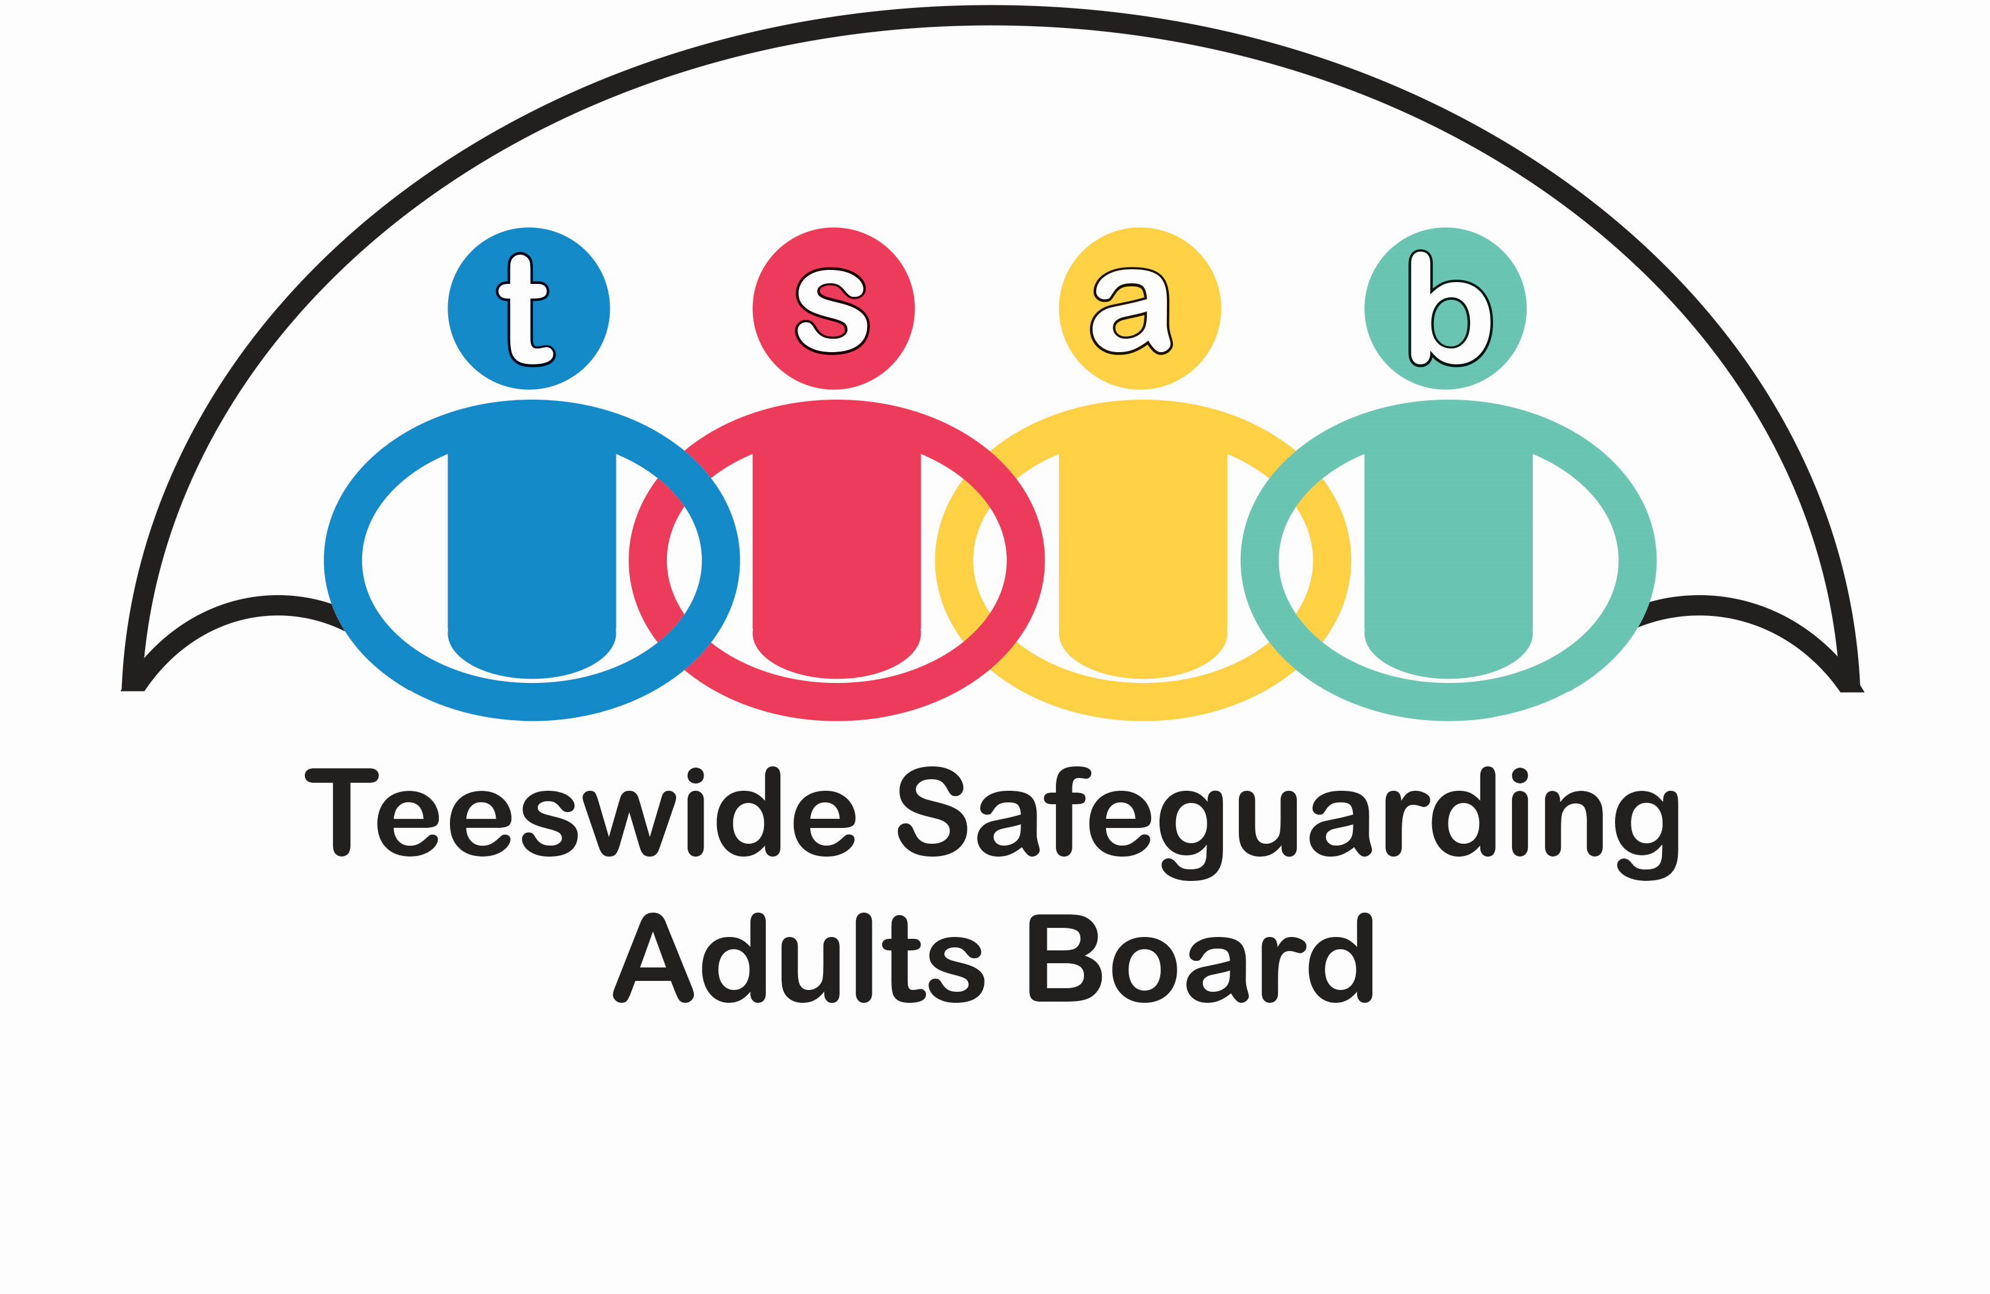
Jack SAR
Mike Ward - Independent Reviewer

Slide 2
Pen picture
Jack was 20 when he died
White British male of local origin
Found deceased in a hotel room in January 2023
He had a history of substance use, homelessness and self-neglect
He had been diagnosed with type 1 diabetes at the age of 5
He died of diabetic ketoacidosis

Slide 3
Pen picture
His home environment was strained while growing up particularly because his father was a drug user. Jack was a child in need
His mother described Jack as a “cheeky northern rogue”. He loved family and friends and was very sociable.
He also loved computers and music especially drill music.
He was using cannabis from the age of 15/16. He became involved with young people’s Drug and Alcohol Services and did well with them.
After leaving school he went to college but Covid interrupted this and in this period he began using crack cocaine.

Slide 4
Family relationships
He had a mother and a sister who were involved in his care.
We have spoken to them at points in this process.

Slide 5
Transition
A key question is whether he should have received greater support from services as he transitioned into adulthood.
The transition into adult diabetes care was very well managed
However, there is a need to recognise that some “children in need” will need more follow-up support.
The report recommends that people like Jack with patterns of poorly managed diabetes and at risk of substance misuse will need more input

Slide 6
Diabetes
The specialist management of Jack’s diabetes was very positive and, indeed, assertive.
The simple message, which is repeated from the Josh SAR, is that agencies generally need to be regularly reminded of the very specific needs of people with diabetes

Slide 7
Alcohol and drug misuse
Jack is described as having a problem with cannabis and cocaine.
A robust response to substance use disorders will be to ensure that all generic services identify and address substance use disorders at the earliest point. This will require the widespread and consistent use of drug and alcohol screening tools such as DUDIT, Assist-Lite or AUDIT.
Although Jack’s substance use remained unresolved. The central learning appears to be that as both a young person and as an adult, the approach that was most effective with him was assertive outreach.

Slide 8
Engagement
The fundamental challenge with Jack was not that he had a drug use disorder or diabetes or that he was homeless. The real challenge was that services found it difficult to engage him into the care he needed for those problems.
Highlights the need for a published, multi-agency procedure to guide professionals in dealing with engagement problems.
This will need to cover themes including:
Multi-agency management
Assertive outreach
Guidance on engagement techniques
The need for a longer term view of the situation.

Slide 9
Housing
In the short period of his adult life, Jack became very difficult to house due to his behaviour.
A frequent comment in both the IMRs and the Practitioners’ Event was the lack of local residential options for vulnerable people, people with challenging presentations and those with diabetes in particular.
However, Jack’s case does highlight two specific issues:
Discharge from Hospital to homelessness
The problem of moving authority

Slide 10
Safeguarding and Section 9 referrals
Jack was subject to two adult safeguarding concerns and a section 9 referral to Middlesbrough Adult Social Care during the review period. There were also four requests for service during the period. Other safeguarding concerns were raised about him during his adult life. As a result, work was undertaken to safeguard him and more widely to assess and address his care and support needs.
At least two possible missed opportunities to raise a safeguarding concern are identified.
His GP also notes that self-neglect does not appear to have been picked up consistently.
This raises the question of whether all workers identified Jack’s poor management of diabetes as self-neglect.

Slide 11
Mental capacity
At no point is Jack assessed or viewed as lacking the capacity to care for himself.
Jack may have understood and retained information about his problems; but he did not take the steps that he stated were required to protect himself.
Therefore, in assessing capacity with vulnerable and self-neglecting individuals like Jack it is important to consider whether someone can both make a decision and put it into effect (i.e. use information)?

Slide 12
Cognitive impairment
There is growing concern that cognitive impairment, particularly acquired brain injury, is a factor in the presentation of many of the people who are subject to SARs.
At no point was Jack diagnosed as someone with a cognitive impairment; however, he did suffer at least two serious head injuries.
This is a reminder of the importance of considering cognitive functioning with individuals who require safeguarding.

Slide 13
Smoking
Jack was a longstanding cigarette smoker.
This is a minor issue in this SAR but it is important that agencies consider the impact of smoking because of the range of associated risk and its complicating effect on diabetes.
Addressing smoking could have been a positive step towards health promotion and engagement with Jack.

Slide 14
Josh SAR
The report reviews Jack against the findings in the Josh SAR and identifies areas where there are crossovers e.g. Mental Capacity, homelessness legislation, multi-agency working.

Slide 15
Good practice
The work of both the Paediatric and Adult Diabetes Nurses is an example of best practice in working with a long-term condition. In particular, the focus on ensuring a successful transition is a model for all transitions.
The Young People’s Drug and Alcohol Worker who has supported Jack and, subsequently, his family is an example of practice that goes beyond expectations.
The Drug and Alcohol Services generally were proactive and supportive in working with Jack. It should be noted that a quiet space for reflection has been set up in the Drug and Alcohol Service in memory of him.

Slide 16
Recommendations
Recommendation A - The Safeguarding Adult Board should lead local discussions on whether there are specific groups of young people (other than looked after children) who require ongoing support as they transition into adulthood. This should specifically consider the needs of young people with poorly managed diabetes and/or substance use disorders.
Recommendation B - Public Health Commissioners who commission and plan the development of drug and alcohol services should ensure that all frontline services are aware of, and are able to use, robust drug and alcohol screening tools such as the AUDIT or Assist-Lite tools to identify and record the level of substance related risk for clients.

Slide 17
Recommendations
Recommendation C - Public Health Commissioners who commission and plan the development of drug and alcohol services should review whether the specific needs and impacts of people with substance use disorders that practitioners find difficult to engage in mainstream services are addressed in any future commissioning plans. In particular, investment in assertive outreach capacity for this group of clients should be considered locally.
Recommendation D - The Safeguarding Adult Board should lead the development of local procedures that guide professionals on how to respond to individuals requiring safeguarding but whom agencies find difficult to engage. (These protocols could equally apply to vulnerable clients outside of the safeguarding context).

Slide 18
Recommendations
Recommendation E - The Safeguarding Adult Board should ensure that those procedures include the option of assertive outreach and recognise the need to escalate the more vulnerable clients, to a local multi-agency forum for joint management. The SAB should ensure that the importance of escalating concerns about more vulnerable clients is cascaded as widely as possible through their own and partner agency communication systems.
Recommendation F - The Safeguarding Adult Board should reassure itself that the Duty to Refer in the Homelessness Reduction Act 2017 is being consistently and appropriately used by all appropriate services.

Slide 19
Recommendations
Recommendation G - The Safeguarding Adult Board should lead discussions about the need for more, and more appropriate, housing for people with complex presentations, particularly those who are difficult to manage in services.
Recommendation H - The Safeguarding Adult Board should remind housing professionals to carefully consider the risks associated with placing a vulnerable person out of area.
Recommendation I - The Safeguarding Adult Board should ensure that there is ongoing training and messaging to highlight that both poorly managed diabetes and some patterns of substance use are a form of self-neglect and that there is a need to raise safeguarding concerns about such individuals.

Slide 20
Recommendations
Recommendation J - The Safeguarding Adult Board should ensure that training and guidance are available to support professionals to consider the use of the Mental Capacity Act in the context of clients that agencies find difficult to engage generally. This should include reminders about the importance of considering whether someone can both take a decision and put it into effect.
Recommendation K - The Safeguarding Adult Board should ensure that work is taking place to highlight and address the impact of acquired brain injury on people who require safeguarding.
Recommendation L - The Public Health Team should ensure that all frontline services are aware of the importance of addressing smoking with vulnerable individuals because of the associated health and fire risks.

